Slide 1
Machine Learning introduction
Abdelrahman Ayad
March 18, 2021

Slide 2
Notes:
The McGill initiative on Computational Medicine was formed in 2017 and aims to deliver inter-disciplinary research programs and empower the use of data in health research and health care delivery
Located at the Genome Center
They have a newsletter were you can subscribe to
more info on the web site

Slide 3
Personal Introduction
Abdelrahman Ayad
PhD student – ECE department McGill University
Research area: modern power systems and energy systems modeling
Triathlon, skydiving, and reading

Slide 4
Personal Introduction
Audrey Baguette
PhD student - Quantitative Life Sciences
3D conformation of chromatin and its relation to gene expression

Slide 5
Workshop agenda
Machine Learning (ML) introduction
ML models, tasks, and important concepts
Decision Trees (DTs)
Concepts
Coding exercises
Artificial Neural Networks (ANNs)
Concepts
Coding exercises
Coding competition
Next steps
Q&A

Slide 6
Materials on github
Github repo: https://github.com/abdelrahman-ayad/MiCM-introML-W21

Slide 7

Terminologies
Artificial Intelligence (AI)
Broader science (domain) of incorporating human intelligence to machines
Machine Learning (ML)
Subset of AI, provides computer ability to learn and improve from experience
Many algorithms: Artificial Neural Networks (ANNs), Support Vector Machines (SVM), Decision Trees (DTs) , …
Deep Learning (DL)
Evolution of ML
Advanced models of ANN
Extracting and finding features
Data Science
Umbrella term for the above
Widely used in industry
Includes data mining
https://blogs.nvidia.com/blog/2016/07/29/whats-difference-artificial-intelligence-machine-learning-deep-learning-ai/

Slide 8
ML definitions
Technical definition
“A computer program is said to learn from experience E with respect to some class of tasks T and performance measure P, if its performance at tasks in T, as measured by P, improves with experience E” - Tom Mitchel
Less formal
- “Computer systems that automatically improve with experience”
- ML is the set of “algorithms and statistical models that computer systems use to perform a specific task without using explicit instructions”

Slide 9
ML short history
1950: Turing Test
Test if the machine can imitate humans
1956: Checker player that learned that as it played (Arthur Samuel)
Coined the term Machine Learning
1958: First Artificial Neural Network, Perceptron and Adeline
1970-1980: ruled based and symbolic AI
Expert systems dominates industry
1980-1990: expert systems replaced by general-purpose computers
2012 – Now: new era of AI and Deep Learning
Future: What is next?
AI and ML in virtually all domains
Hypes followed by disappointments?
Notes:
Expert systems: knowledge based systems (if-then)

Slide 10
ML broad tasks
Classification
Output: Binary or multiple classes
E.g., images classification, cancer detection, email spams
Regression
Output: Continuous or discrete
E.g., weather forecasting, stock price prediction
Clustering
Partitioning data into regions
Not an exhaustive list

Slide 11
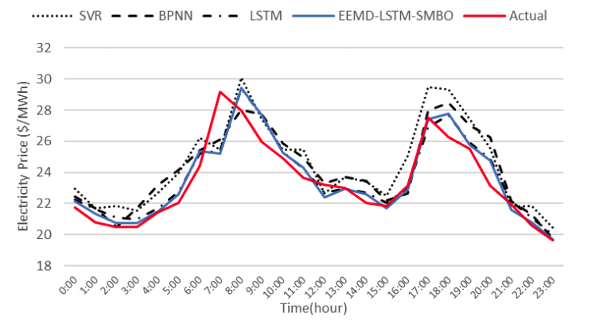
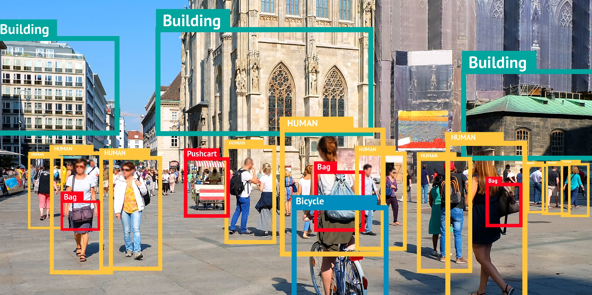
ML models
Supervised learning
We have labeled data (input and output)
Classification, regression, ranking
Zhou et al. “An Optimized heterogeneous structure LSTM Network for Price Forecasting”, 2019.
https://bitmovin.com/object-detection/

Slide 12
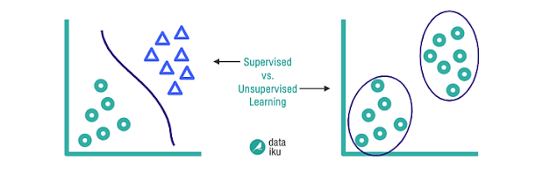
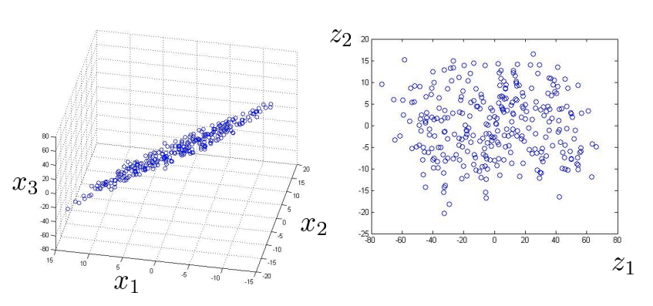
ML models
Unsupervised learning
We don’t provide labels (only input)
Clustering, dimensionality reduction
https://blog.dataiku.com/clustering-how-it-works-in-plain-english

Slide 13
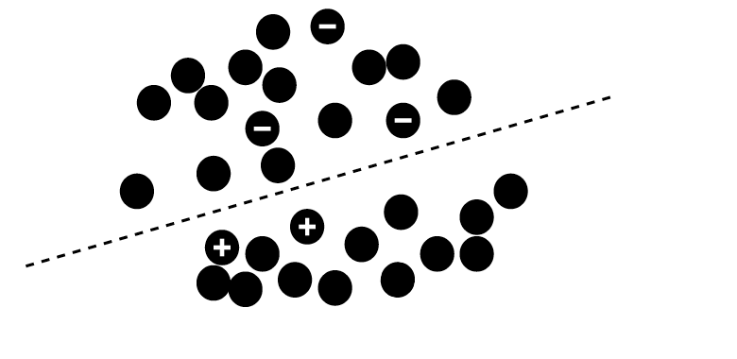
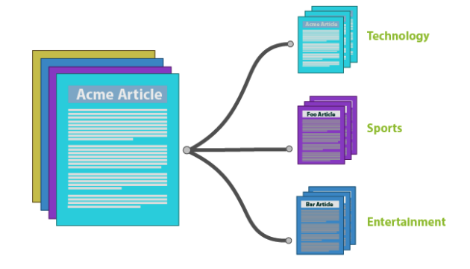
ML models
Semi-supervised learning
Only a subset of data is labeled (some output)
https://github.com/javedsha/text-classification

Slide 14
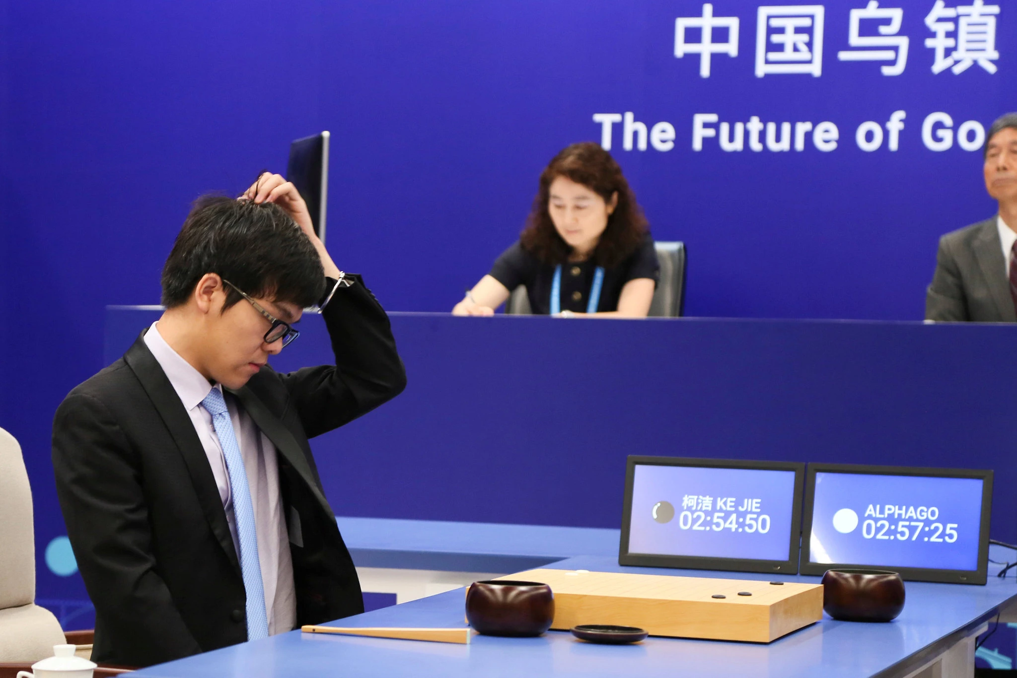
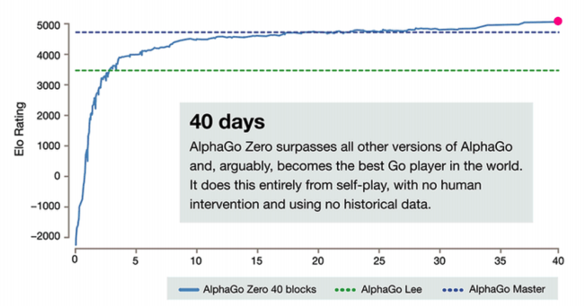
ML models
Unsupervised learning
Reinforcement learning
Agent that gets explores an environment and gets rewards
Ke Jie, the world’s top Go player, reacting during his match on Tuesday against AlphaGo, artificial intelligence software developed by a Google affiliate. Credit...China Stringer Network, via Reuters. May 23, 2017
https://deepmind.com/blog/article/alphago-zero-starting-scratch

Slide 15
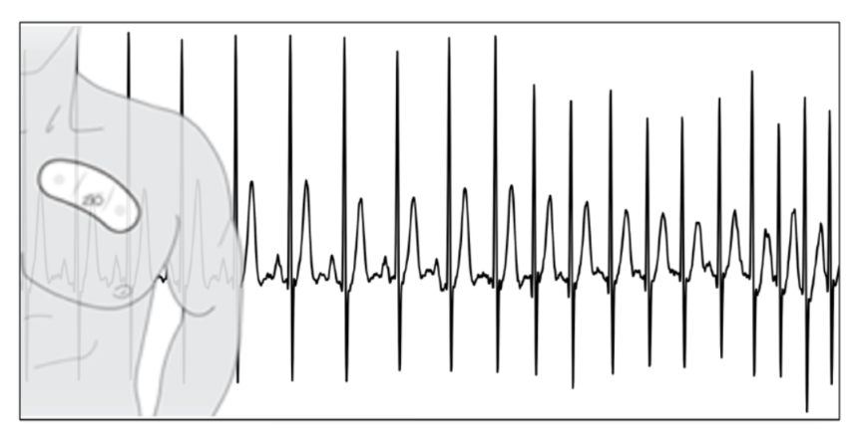
ML applications
Theoretical vs Applied ML
Importance of domain knowledge
Data pre-processing
Results interpretation
Dealing with messy and unstructured data
ECG data: Rajpurkar et al., 2017

Slide 16
ML main concepts
Learning = Representation + Evaluation + Optimization
Representation: Features Space
Evaluation: Objective function
Measure how good the model is
Error between prediction and actual target
Optimization: Improve and minimize the error
Adjust model parameters to decrease error
Repeat until convergence

Slide 17
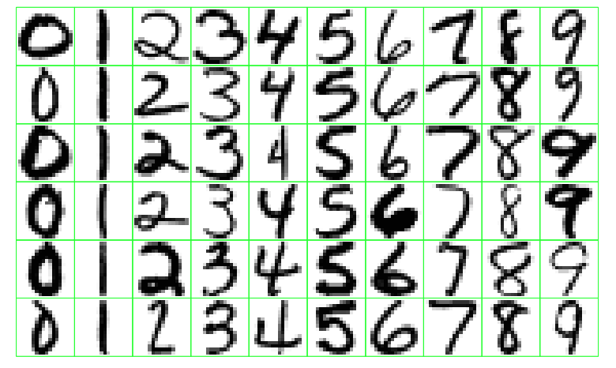
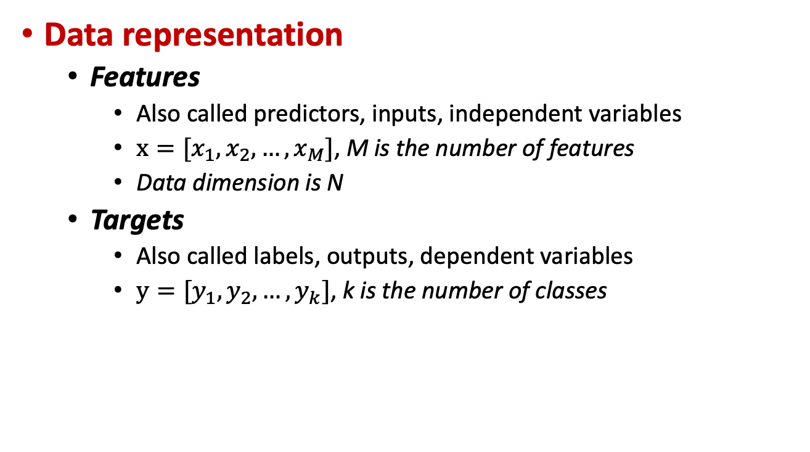
ML main concepts
Data representation
Features
Also called predictors, inputs, independent variables
$x=[x_{1}, x_{2}, …, x_{M}]$, M is the number of features
Data dimension is N
Targets
Also called labels, outputs, dependent variables
$y=[y_{1}, y_{2}, …, y_{k}]$, k is the number of classes
Classes
N Samples

Slide 18
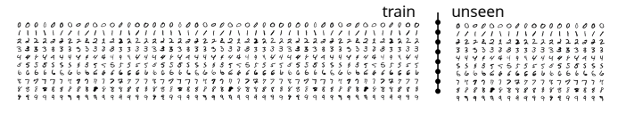
ML main concepts
Model selection
Create a model based on some data points (training) and then apply the model on unseen data (testing / real world)

Slide 19
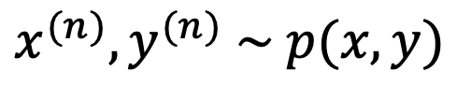
ML main concepts
Model selection
Create a model based on some data points (training) and then apply the model on unseen data (testing / real world)
Assumptions
1) Training points are samples from an unknown distribution
2) training and unseen data come from the same distribution
$$x^{(n)}, y^{(n)} \sim p(x, y)$$

Slide 20
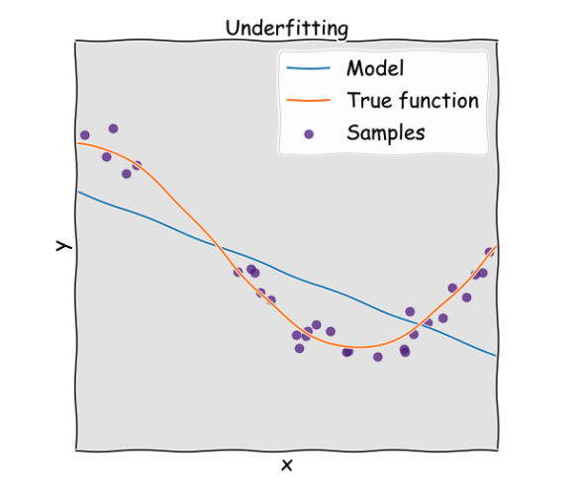
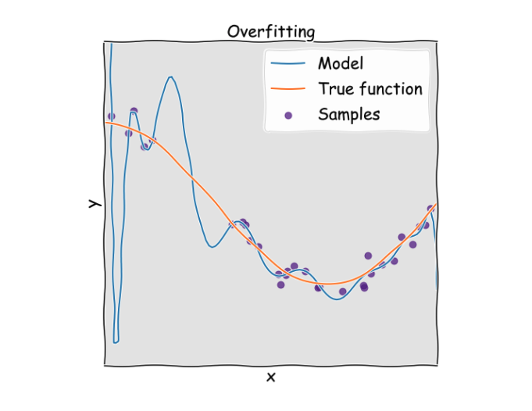
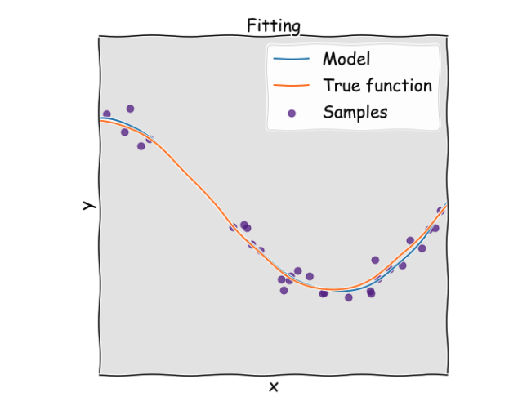
ML main concepts
Data split into training and testing sets
Avoids overfitting
Important for generalization in the real world
https://keeeto.github.io/blog/bias_variance/

Slide 21
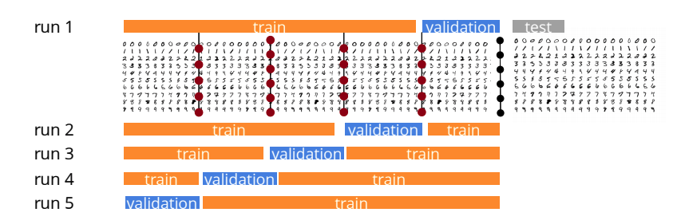
ML main concepts
Data split into training and testing sets
Avoids overfitting
Important for generalization in the real world
Cross validation
www.siamak.page/courses

Slide 22
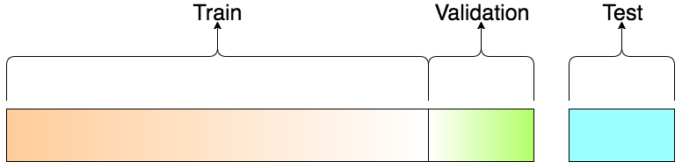
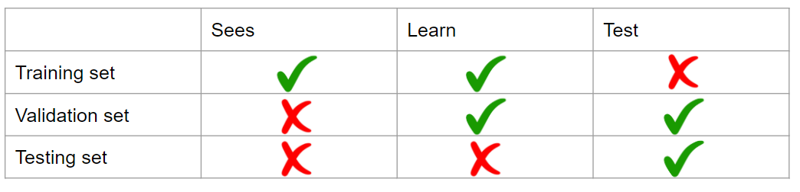
ML main concepts
Data split into training and testing sets
Avoids overfitting
Important for generalization in the real world
Cross validation

Slide 23
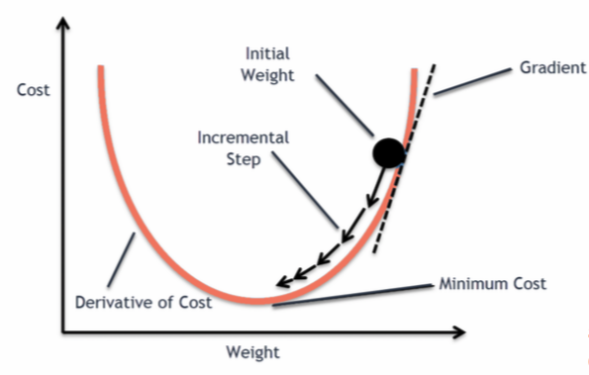
ML main concepts
Optimization: Minimize an objective function
What is a learning algorithm?
Iterative approach
E.g., Gradient descent
https://blog.clairvoyantsoft.com/the-ascent-of-gradient-descent-23356390836f

Slide 24
ML main concepts
Building a model
Objective definition
Data preparation
Model selection
1
Training
Evaluation
Parameters tuning
Learning on
Training data
2
Predicting on
Testing data
3
Inference
Final model

Slide 25
Decision Trees (DTs)
Main idea: Divide space into regions using a tree structure
Classification tasks: class label
Regression tasks: real scalar
Motivations:
Handling of categorical variables.
Handling of missing values and unknown values.
Detection of non-linear relationships.
Visualization and interpretation in decision trees.

Slide 26
DTs motivation
Intuitive way to classify objects
Series of questions
Split based on answer = threshold

Slide 27
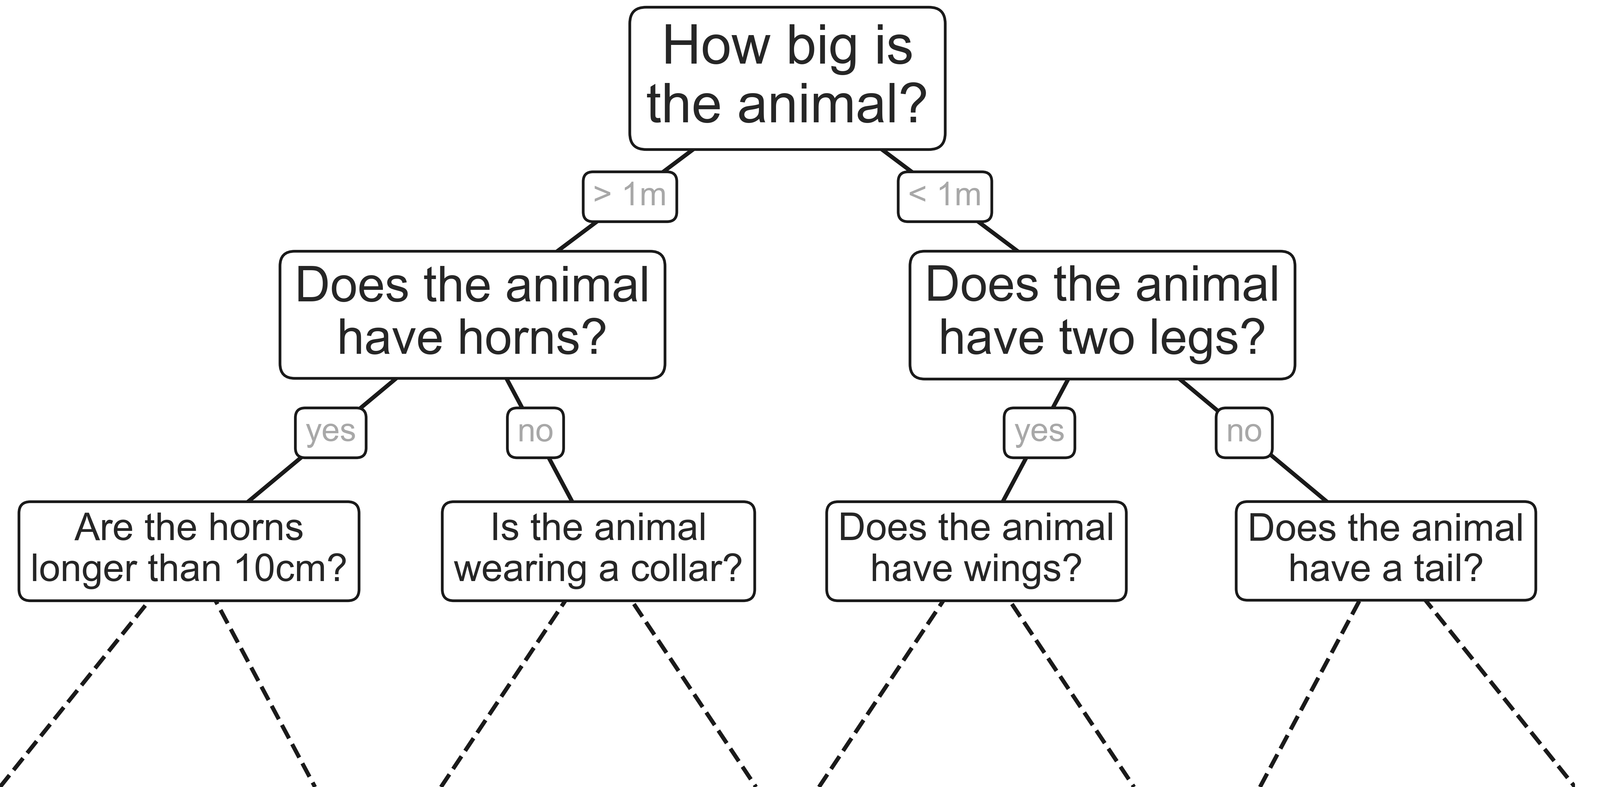
DTs motivation
Intuitive way to classify objects
Series of questions
Split based on answer = threshold
E.g., classify animals

Slide 28
DTs motivation
Intuitive way to classify objects
Series of questions
Split based on answer = threshold
E.g., classify animals

Slide 29
DTs motivation
Intuitive way to classify objects
Series of questions
Split based on answer = threshold
E.g., classify animals

Slide 30
DTs motivation
Intuitive way to classify objects
Series of questions
Split based on answer = threshold
E.g., classify animals

Slide 31
DTs motivation
Intuitive way to classify objects
Series of questions
Split based on answer = threshold
E.g., classify animals

Slide 32
DTs motivation
Intuitive way to classify objects
Series of questions
Split based on answer = threshold
E.g., classify animals

Slide 33
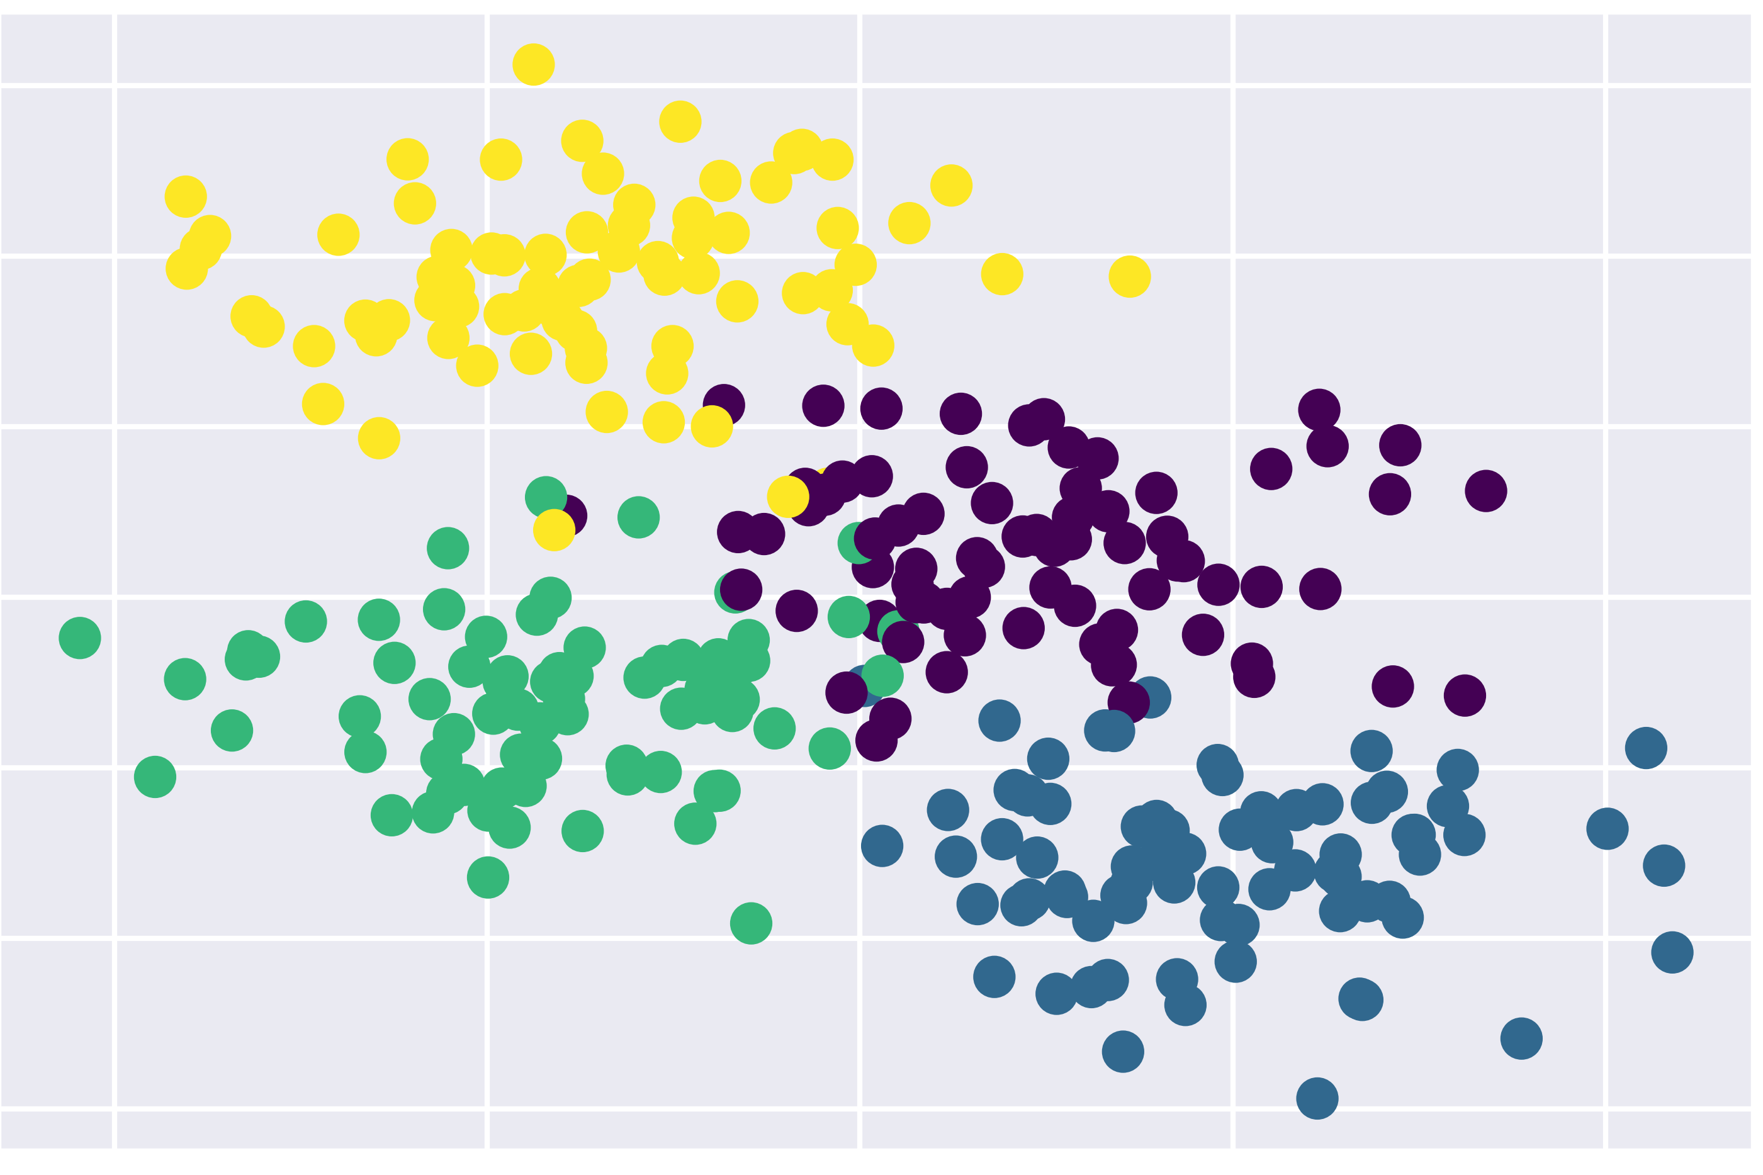
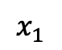
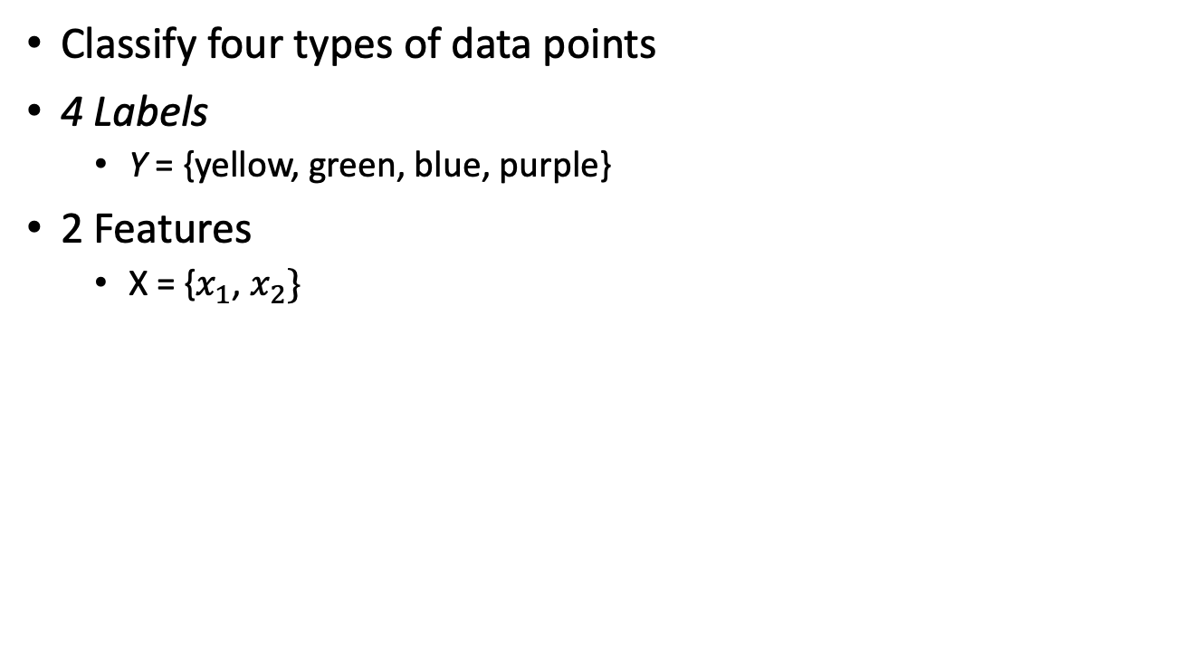
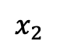
DTs example
Classify four types of data points
4 Labels
Y = {yellow, green, blue, purple}
2 Features
X = {$x_{1}$, $x_{2}\}$
$$x_{2}$$
$$x_{1}$$

Slide 34
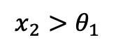
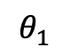
DTs example
$$x_{2}>θ_{1}$$
$$x_{2}$$
$$θ_{1}$$
$$x_{1}$$

Slide 35
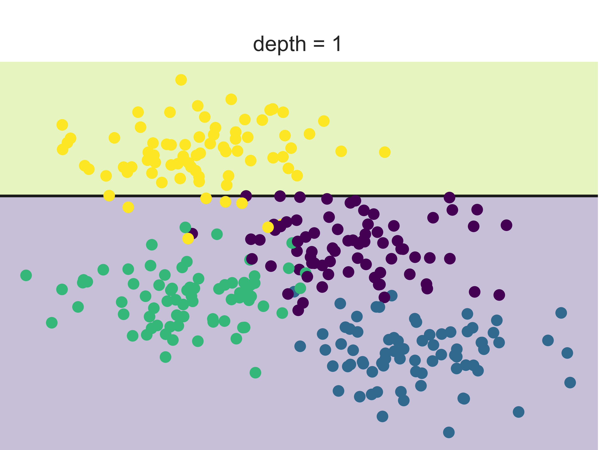
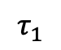
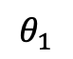
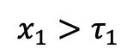
DTs example
$$x_{2}>θ_{1}$$
$$x_{1}>τ_{1}$$
$$x_{2}$$
yellow
$$θ_{1}$$
$$τ_{1}$$
$$x_{1}$$

Slide 36
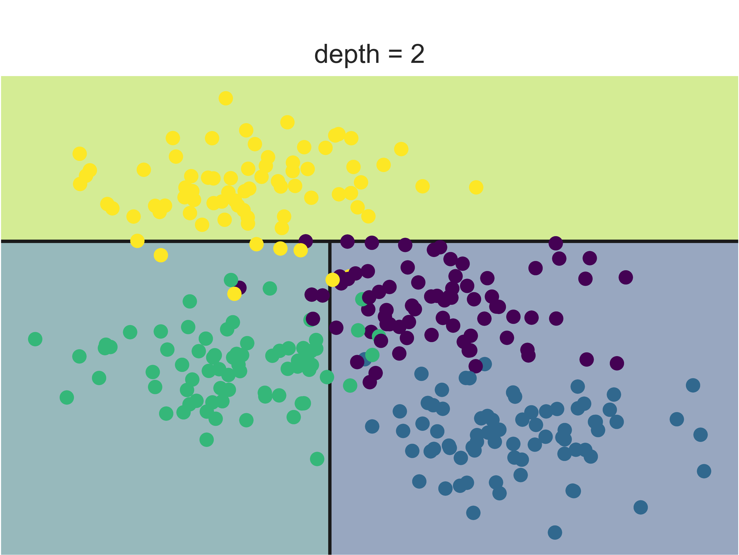
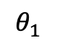
DTs example
$$x_{2}>θ_{1}$$
$$x_{1}>τ_{1}$$
$$x_{2}$$
yellow
$$θ_{1}$$
Green
$$τ_{1}$$
$$x_{1}$$

Slide 37
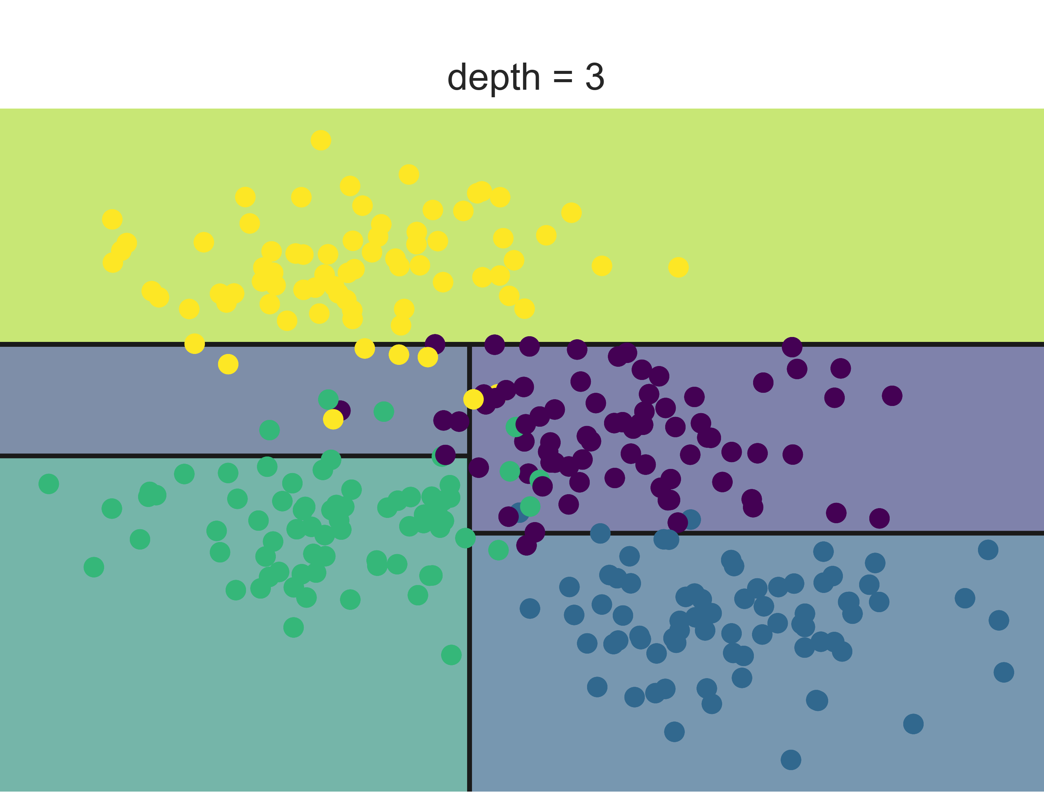
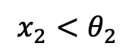
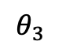
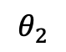
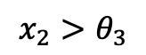
DTs example
$$x_{2}>θ_{1}$$
$$x_{1}>τ_{1}$$
$$x_{2}$$
yellow
$$θ_{1}$$
$$θ_{2}$$
$$θ_{3}$$
$$x_{2}<θ_{2}$$
$$x_{2}>θ_{3}$$
$$τ_{1}$$
$$x_{1}$$

Slide 38
DTs example
$$x_{2}>θ_{1}$$
$$x_{1}>τ_{1}$$
$$x_{2}$$
yellow
$$θ_{1}$$
$$θ_{2}$$
$$θ_{3}$$
$$x_{2}<θ_{2}$$
$$x_{2}>θ_{3}$$
$$τ_{1}$$
$$x_{1}$$
purple
Green
blue
purple

Slide 39
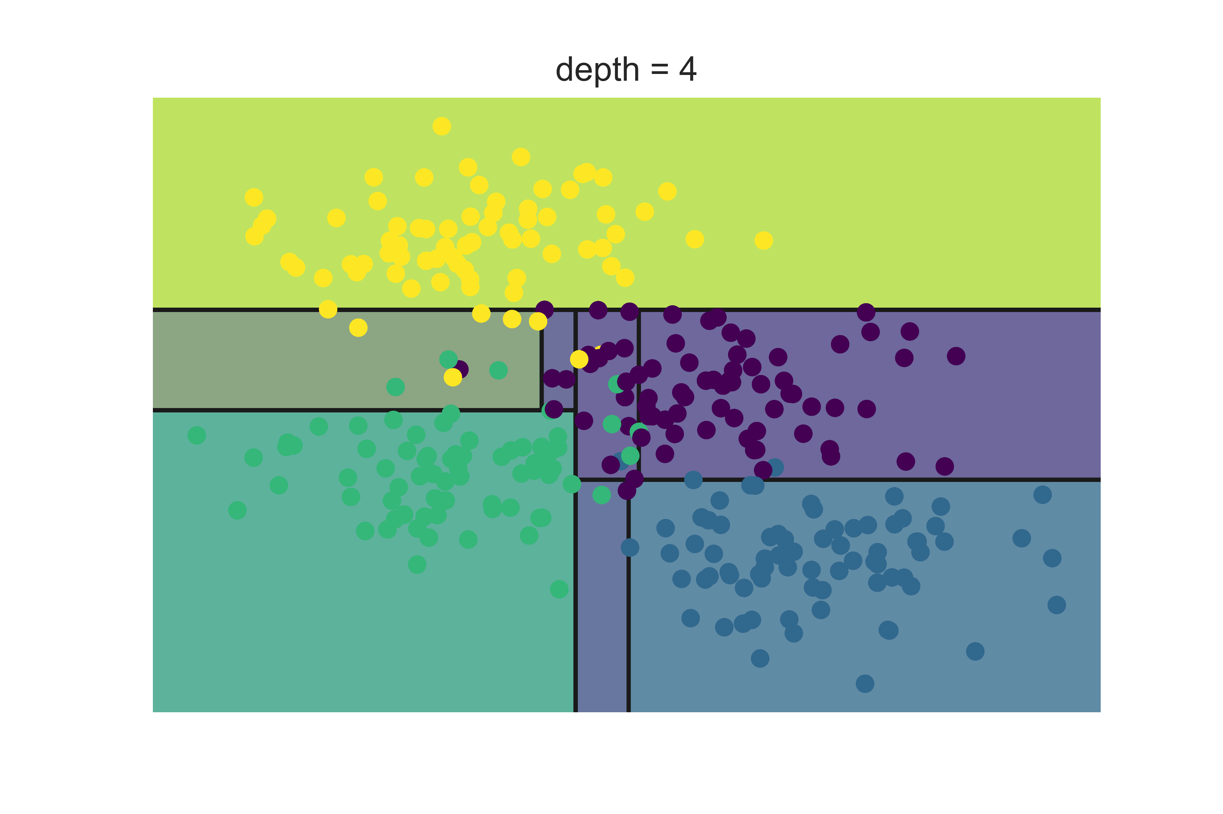
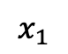
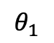
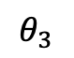
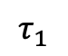
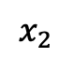
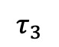
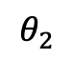
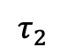
DTs example
The process is iterative..
When to stop?
$$x_{2}$$
$$θ_{1}$$
$$θ_{2}$$
$$θ_{3}$$
$$τ_{3}$$
$$τ_{2}$$
$$τ_{1}$$
$$x_{1}$$

Slide 40
Building a DT
What is a good DT?
How to define the error?
How to split?
When to stop?

Slide 41
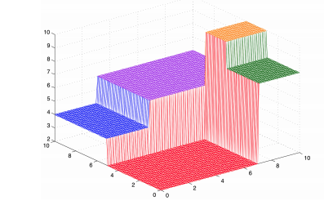
Building a DT
What is a good DT?
Homogenous space
Same elements in same region: low error

Slide 42
Building a DT
How to define the error?
Count misclassification
Measure of homogenous

Slide 43
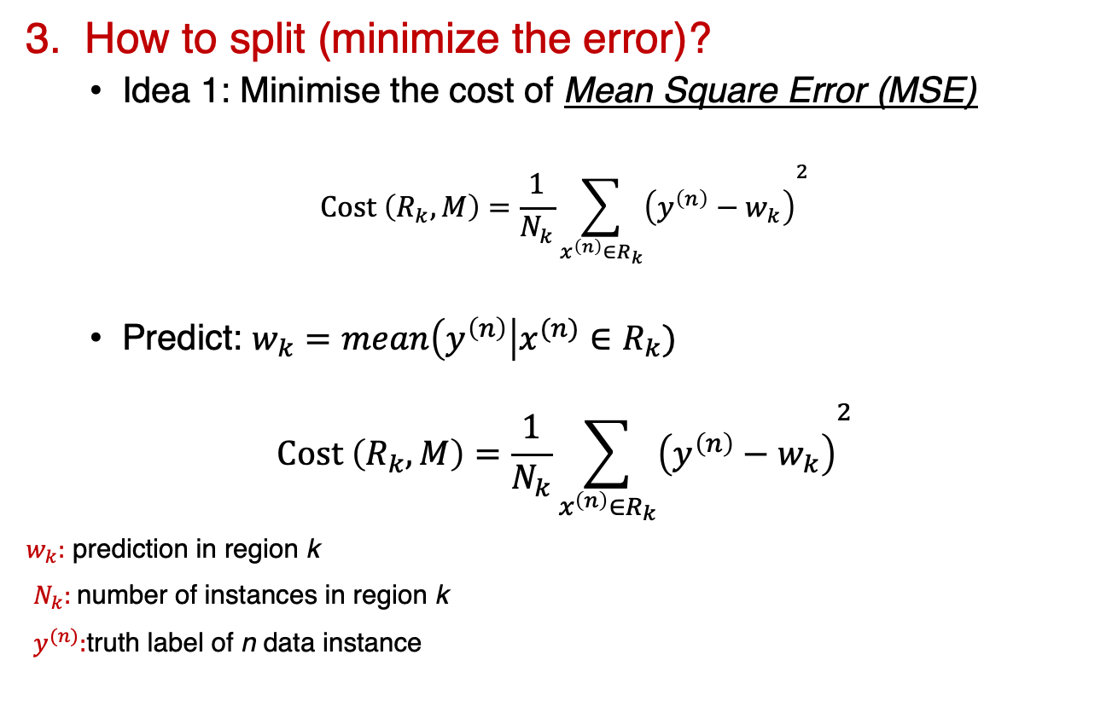
Building a DT
3. How to split (minimize the error)?
Idea 1: Minimise the cost of Mean Square Error (MSE)
$$Cost \left(R_{k}, M\right)=\frac{1}{N_{k}}{\sum_{x^{\left(n\right)}∈R_{k}}{\left(y^{\left(n\right)}−w_{k}\right)}}^{2}$$
Predict: $w_{k}=mean\left(y^{\left(n\right)}\right|x^{(n)}∈R_{k})$
$$Cost \left(R_{k}, M\right)=\frac{1}{N_{k}}{\sum_{x^{\left(n\right)}∈R_{k}}{\left(y^{\left(n\right)}−w_{k}\right)}}^{2}$$
$w_{k}:$ prediction in region k
$N_{k}:$number of instances in region k
$y^{(n)}:$truth label of n data instance

Slide 44
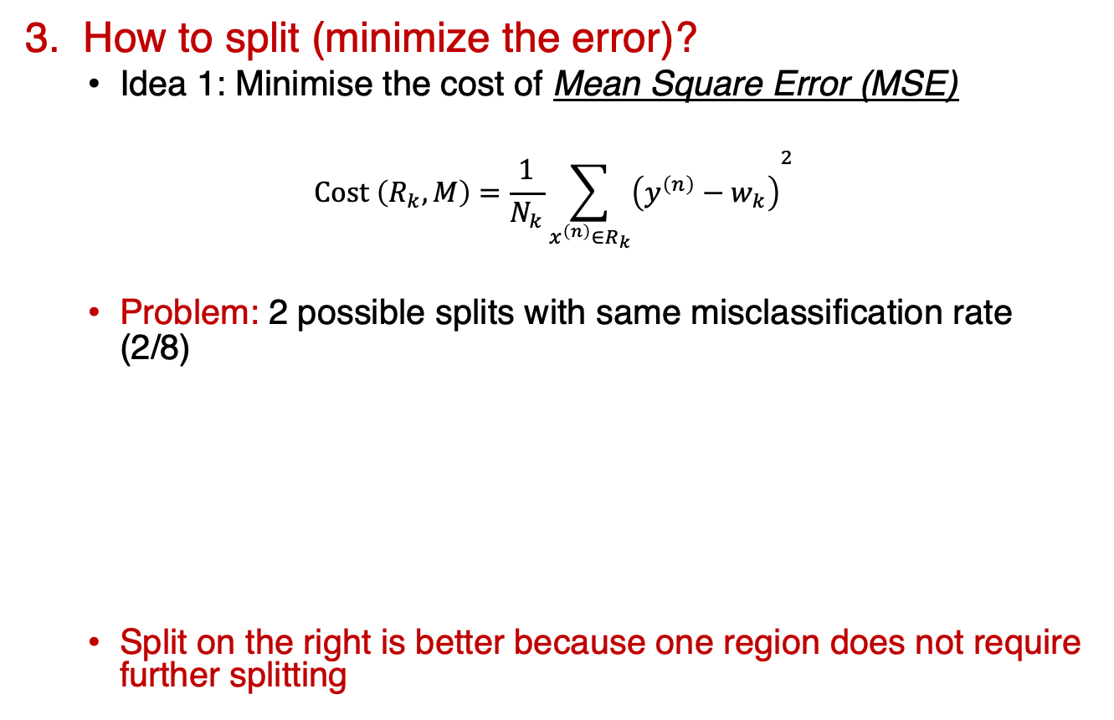
Building a DT
3. How to split (minimize the error)?
Idea 1: Minimise the cost of Mean Square Error (MSE)
$$Cost \left(R_{k}, M\right)=\frac{1}{N_{k}}{\sum_{x^{\left(n\right)}∈R_{k}}{\left(y^{\left(n\right)}−w_{k}\right)}}^{2}$$
Problem: 2 possible splits with same misclassification rate (2/8)
Split on the right is better because one region does not require further splitting
4 Blue
4 Yellow
4 Blue
4 Yellow
3 Blue
1 Yellow
1 Blue
3 Yellow
4 Blue
2 Yellow
2 Yellow

Slide 45

Building a DT
3. How to split (minimize the error)?
Idea 2: Information gain and homogeneity measure
Entropy: expected amount of information in observing a random variable (y)
$$H\left(y\right)=−\sum_{c=1 }^{C}{p\left(y=c\right)\log{p(y=c)}}$$
$−\log{p \left(y=c\right)}:$ amount of information in observing c
Mutual information: amount of information t conveys about y
$$I\left(t, y\right)=H\left(y\right)−H(y|t)$$
$Cost \left(R_{k}, D\right)=H(y)$ choose the split with the lowest entropy
Choose the test which is maximally informative about labels

Slide 46



Building a DT
3. How to split (minimize the error)?
Idea 2: Information gain and homogeneity measure
Entropy: expected amount of information in observing a random variable (y)
$$H\left(y\right)=−\sum_{c=1 }^{C}{p\left(y=c\right)\log{p(y=c)}}$$
4 Blue
4 Yellow
4 Blue
4 Yellow
3 Blue
1 Yellow
1 Blue
3 Yellow
4 Blue
2 Yellow
2 Yellow
$$\frac{4}{8}(−\frac{1}{4}\log\left(\frac{1}{4}\right)−\frac{3}{4}\log\left(\frac{3}{4}\right)+\frac{4}{8}(−\frac{1}{4}\log\left(\frac{1}{4}\right)−\frac{3}{4}\log\left(\frac{3}{4}\right))=0.81$$
$\frac{6}{8}(−\frac{1}{3}\log\left(\frac{1}{3}\right)−\frac{2}{3}\log\left(\frac{2}{3}\right))+\frac{4}{8}($0) = 0.68

Slide 47

Building a DT
When to stop?
DTs are prone to overfitting
Trial and error
Hyper-parameters tuning
Validation sets
https://elitedatascience.com/overfitting-in-machine-learning

Slide 48
DTs demo
Homes in San Francisco vs New York
Guess (classify) the location based on homes features
Elevation
Year built
Bathrooms
Bedrooms
Price
Prediction: San Francisco or New York

Slide 49

Break
15 minutes

Slide 50
DTs coding session
Colab / Jupyter notebook
We will check a solved DT example
Then work in groups on a DT exercise (~15 mins)

Slide 51


Artificial Neural Networks (ANNs)
It begins with a neuron
https://cs231n.github.io/neural-networks-1/
Notes:
The basic computational unit of the brain is a neuron. Approximately 86 billion neurons can be found in the human nervous system and they are connected with approximately 10^14 - 10^15 synapses.
Each neuron receives input signals from its dendrites and produces output signals along its (single) axon. The axon eventually branches out and connects via synapses to dendrites of other neurons.
In the computational model of a neuron, the signals that travel along the axons (e.g. x0x0) interact multiplicatively (e.g. w0x0w0x0) with the dendrites of the other neuron based on the synaptic strength at that synapse (e.g. w0w0). The idea is that the synaptic strengths (the weights ww) are learnable and control the strength of influence (and its direction: excitory (positive weight) or inhibitory (negative weight)) of one neuron on another. In the basic model, the dendrites carry the signal to the cell body where they all get summed. If the final sum is above a certain threshold, the neuron can fire, sending a spike along its axon.

Slide 52


Building ANNs
Activation function
Based on the input signal, fire the neuron or not
Make a decision: 0 / 1
Squash the input into a value between 0 and 1
Sigmoid function: $σ\left(x\right)=\frac{1}{(1+e^{−x})}$
Not the only activation function

Slide 53








Building ANNs
$$x_{1}$$
$$w_{1}$$
$$Sum weighted inputs and \\ Activation function$$
$$x_{2}$$
$$w_{1}$$
$$y$$
$$w_{1}$$
$$x_{3}$$

Slide 54











Building ANNs
$$X=\left[5, 3, 1\right] \\ W_{0}=[0.4, 0.1, 0.3] \\ y_{true}=0$$
$$5$$
$$0.4$$
$$Sum weighted inputs and \\ Activation function$$
$$3$$
$$0. 1$$
$$y_{true}=0$$
$$0.3$$
$$\sum{w_{i}x_{i}=2.6}$$
$$σ\left(2.6\right)=1$$
$$y_{pred}=1$$
$$1$$

Slide 55




Building ANNs
$$X=\left[5, 3, 1\right] \\ W_{1}=[−0.4, 0.1, −0.3] \\ y_{true}=0$$
$$5$$
$$0.4$$
$$Sum weighted inputs and \\ Activation function$$
$$3$$
$$0. 1$$
$$y_{true}=0$$
$$0.3$$
$$\sum{w_{i}x_{i}=−2}$$
$$σ\left(−2\right)=0$$
$$y_{pred}=0$$
$$1$$

Slide 56

Building ANNs
How did we change the weights from $W_{0} to W_{1}$
This is the core of ANNs!
Iterative modification of the weights
Learning algorithms:
Gradient descent
Stochastic gradient descent
Adam
Feedforward and backpropagation

Slide 57
















ANNs example
$$w_{1}$$
$$w_{5}$$
$$y_{1}$$
$$x_{1}$$
$$h_{1}$$
$$w_{3}$$
$$w_{6}$$
$$w_{7}$$
$$w_{2}$$
$$x_{2}$$
$$h_{2}$$
$$y_{2}$$
$$w_{4}$$
$$w_{8}$$
$$b_{1}$$
$$b_{2}$$
1
1

Slide 58










ANNs example
$x_{1}$ = 0.05
$$w_{1}=0.15$$
$$w_{5}$$
$$y_{1}$$
$$h_{1}$$
$$w_{3}=0.25$$
$$w_{6}$$
$$w_{7}$$
$$w_{2}=0.2$$
$$x_{2}=0.1$$
$$h_{2}$$
$$y_{2}$$
$$w_{4}=0.3$$
$$w_{8}$$
$$b_{1}$$
$$b_{2}$$
1
1
$${y_{true}}_{1}=0.01$$
$$h_{1}=w_{1} ∗x_{1}+w_{2} ∗x_{2}+b_{1} ∗1=0.3775$$
$${y_{true}}_{2}=0.99$$

Slide 59


ANNs example
$x_{1}$ = 0.05
$$w_{1}=0.15$$
$$w_{5}$$
$$y_{1}$$
$$h_{1}$$
$$w_{3}=0.25$$
$$w_{6}$$
$$w_{7}$$
$$w_{2}=0.2$$
$$x_{2}=0.1$$
$$h_{2}$$
$$y_{2}$$
$$w_{4}=0.3$$
$$w_{8}$$
$$b_{1}$$
$$b_{2}$$
1
1
$${y_{true}}_{1}=0.01$$
$$h_{1}=w_{1} ∗x_{1}+w_{2} ∗x_{2}+b_{1} ∗1=0.3775$$
$${y_{true}}_{2}=0.99$$
$$out_{h_{1}}=σ\left(h_{1}\right)=\frac{1}{1+e^{−h_{1}}}=0.593$$

Slide 60



ANNs example
$$out_{h1}=0.593$$
$x_{1}$ = 0.05
$$w_{1}=0.15$$
$$w_{5}$$
$$y_{1}$$
$$h_{1}$$
$$w_{3}=0.25$$
$$w_{6}$$
$$w_{7}$$
$$w_{2}=0.2$$
$$x_{2}=0.1$$
$$h_{2}$$
$$y_{2}$$
$$w_{4}=0.3$$
$$w_{8}$$
$$b_{1}$$
$$b_{2}$$
1
1
$${y_{true}}_{1}=0.01$$
$$h_{1}=w_{1} ∗x_{1}+w_{2} ∗x_{2}+b_{1} ∗1=0.3775$$
$${y_{true}}_{2}=0.99$$
$$out_{h_{1}}=σ\left(h_{1}\right)=\frac{1}{1+e^{−h_{1}}}=0.593$$

Slide 61


ANNs example
$$out_{h1}=0.593$$
$x_{1}$ = 0.05
$$w_{1}=0.15$$
$$w_{5}$$
$$y_{1}$$
$$h_{1}$$
$$w_{3}=0.25$$
$$w_{6}$$
$$w_{7}$$
$$w_{2}=0.2$$
$$x_{2}=0.1$$
$$h_{2}$$
$$y_{2}$$
$$w_{4}=0.3$$
$$w_{8}$$
$$out_{h2}=0.74$$
$$b_{1}$$
$$b_{2}$$
1
1
$${y_{true}}_{1}=0.01$$
$$h_{2}=w_{3} ∗x_{1}+w_{4} ∗x_{2}+b_{1} ∗1=1.0425$$
$${y_{true}}_{2}=0.99$$
$$out_{h_{2}}=σ\left(h_{2}\right)=\frac{1}{1+e^{−h_{2}}}=0.74$$

Slide 62




ANNs example
$$out_{h1}=0.593$$
$x_{1}$ = 0.05
$$w_{1}=0.15$$
$$w_{5}$$
$y_{1}$ = 0.01
$$h_{1}$$
$$w_{3}=0.25$$
$$w_{6}$$
$$w_{7}$$
$$w_{2}=0.2$$
$$x_{2}=0.1$$
$$h_{2}$$
$y_{2}$ = 0.99
$$w_{4}=0.3$$
$$w_{8}$$
$$out_{h2}=0.74$$
$$b_{1}$$
$$b_{2}$$
1
1
$$y_{1}=out_{h1} ∗w_{5}+out_{h2}∗w7+b_{2}∗1$$
$$out_{y1}=σ\left(y_{1}\right)=0.75$$

Slide 63


ANNs example
$$out_{h1}=0.593$$
$x_{1}$ = 0.05
$$w_{1}=0.15$$
$$w_{5}$$
$y_{1}$ = 0.01
$$h_{1}$$
$$w_{3}=0.25$$
$$w_{6}$$
$$w_{7}$$
$$w_{2}=0.2$$
$$x_{2}=0.1$$
$$h_{2}$$
$y_{2}$ = 0.99
$$w_{4}=0.3$$
$$w_{8}$$
$$out_{h2}=0.74$$
$$b_{1}$$
$$b_{2}$$
1
1
$$out_{y_{1}}=0.75, out_{y_{2}}=0.77$$
$$Error=∑\frac{1}{2}{\left(y_{i}−{y_{pred}}_{i}\right)}^{2}=\frac{1}{2}{( \left(0.01−0.75\right)}^{2}+{\left(0.99−0.77\right)}^{2})=0.29$$

Slide 64

ANNs example
$$Error=∑\frac{1}{2}{\left(y_{i}−{y_{pred}}_{i}\right)}^{2}=\frac{1}{2}{( \left(0.01−0.75\right)}^{2}+{\left(0.99−0.77\right)}^{2})=0.29$$
We want to minimize the error (ideally zero)
Solution: Update the weights
How? Partial derivatives with chain rule (gradient)
Example: role of $w_{5}$in the $Error$
$\frac{∂Error}{∂w5}=\frac{∂Error}{∂out_{y1}} ∗ \frac{∂out_{y1}}{∂out_{h1}} ∗\frac{∂out_{h1}}{∂w5}$

Slide 65

ANNs example
$$\frac{∂Error}{∂w5}=\frac{∂Error}{∂out_{y1}} ∗ \frac{∂out_{y1}}{∂out_{h1}} ∗\frac{∂out_{h1}}{∂w5}$$
$w_{5}^{new}=w_{5} −η∗ \frac{∂Error}{∂w5}$
Where $η$is the learning rate

Slide 66


ANNs example
Gradient descent
The gradient is the steepest descent direction
$$w^{t+1 }=w^{t}−η ∇J(w^{t})$$
$$∇J\left(w\right)=[\frac{∂J\left(w\right)}{∂w_{1}},…,\frac{∂J\left(w\right)}{∂w_{8}}]$$
$J\left(w\right)$ is the cost function (Error function)

Slide 67
ANNs demo
ANNs in action

Slide 68
ANNs coding session
Colab / Jupyter notebook
We will check a solved ANN example
Then work in groups on a ANN exercise (~15 mins)

Slide 69

Important concepts
Categorical variables
One hot encoding
Convert categorical to numerical
Label
A
B
C
A
A
B
C
Label
1
2
3
1
1
2
3

Slide 70

Important concepts
You need to clean the data
Remove NaN and null values
Pandas: pd.dropna()

Slide 71

Performance metrics
Accuracy is only one metric
Definition: proportion of correct cases to all cases
$$Accuracy=\frac{True Positive+True Negative}{Tue Positive+True Negative+False Positive+False Negative}$$
Actual
 | Positive | Negative
Positive | True positive | False Positive
Negative | False Negative | True Negative
Predicted

Slide 72

Performance metrics
Cancer detection test with 99.7% accuracy (impressive?)
100,000 patients
1,000 Malignant (Positive)
99,000 Benign (Negative)
$Accuracy=\frac{850+98,820}{100,000}=99.7\%$
Question 1:
Of all patients that we predicted to have cancer, how many actually have Cancer?
$Precision=\frac{True positive}{True positive+False positive}=\frac{850}{850+180}=82.5\%$
Percentage of results which are relevant
Actual
 | Positive | Negative
Positive | 850 | 180
Negative | 150 | 98, 820
Total | 1,000 | 99,000
Predicted

Slide 73

Performance metrics
Cancer detection test with 99.7% accuracy (impressive?)
100,000 patients
1,000 Malignant (Positive)
99,000 Benign (Negative)
$Accuracy=\frac{850+98,820}{100,000}=99.7\%$
Question 2:
Of all patients that have Cancer, how many did we get right?
$Recall=\frac{True positive}{True positive+False negative}=\frac{850}{850+150}=85\%$
Percentage of total relevant results correctly classified
Actual
 | Positive | Negative
Positive | 850 | 180
Negative | 150 | 98, 820
Total | 1,000 | 99,000
Predicted

Slide 74

Performance metrics
Confusion matrix
For binary and multi-class classification
Correct elements are the diagonals
https://ml4a.github.io/demos/confusion_mnist/

Slide 75
Performance metrics
Accuracy is only one metric
Precision and recall
Confusion matrix
Critical for unbalanced datasets

Slide 76
Break
15 minutes

Slide 77
Coding competition
Work on Titanic dataset

Slide 78

Coding competition
Work on Titanic dataset
Work in groups
Compare DTs, ANNs, and SVMs
30 minutes
Go!

Slide 79
Coding competition
Work on Titanic dataset
Work in groups for 30 minutes
Requirements:
Compare DTs and ANNs
Hyper-parameters tuning?
Apply performance metrics
4 minutes presentation
Bonus: Apply Support Vector Machines (SVM)?
Go Go Go!

Slide 80
Deep Learning
Evolution of ML
Exploits abundance of data
Automatic extraction of features

Slide 81

Deep Learning
Convolutional Neural Networks

Slide 82

Deep Learning
Convolutional Neural Networks
Image classification
Challenges
https://cs231n.github.io/classification/
Notes:
Viewpoint variation. A single instance of an object can be oriented in many ways with respect to the camera.
Scale variation. Visual classes often exhibit variation in their size (size in the real world, not only in terms of their extent in the image).
Deformation. Many objects of interest are not rigid bodies and can be deformed in extreme ways.
Occlusion. The objects of interest can be occluded. Sometimes only a small portion of an object (as little as few pixels) could be visible.
Illumination conditions. The effects of illumination are drastic on the pixel level.
Background clutter. The objects of interest may blend into their environment, making them hard to identify.
Intra-class variation. The classes of interest can often be relatively broad, such as chair. There are many different types of these objects, each with their own appearance.

Slide 83

Deep Learning
Convolutional Neural Networks
0×0+1×1+3×2+4×3=19,
1×0+2×1+4×2+5×3=25,
3×0+4×1+6×2+7×3=37,
4×0+5×1+7×2+8×3=43

Slide 84

Deep Learning
Convolutional Neural Networks
Image classification
https://semiengineering.com/new-vision-technologies-for-real-world-applications/

Slide 85


Deep Learning
Recurrent Neural Networks
Time series analysis
Temporal correlation
Text and speech analysis
http://d2l.ai/chapter_recurrent-neural-networks/rnn.html
https://software.intel.com/content/www/us/en/develop/training/course-time-series-analysis.html

Slide 86
Next steps
Introductory books:
The Elements of Statistical Learning
Information Theory, Inference, and Learning Algorithms
Understanding Machine Learning: From Theory to Algorithms
Dive into Deep Learning
Online resources
Online courses: EdX, Coursera, ...
Datasets and competitions: Kaggle, IEEEDataPort, …
Online articles: Towards Data Science, Medium, …
Google is great ☺

Slide 87
References
http://cs231n.stanford.edu/
https://www.siamak.page/courses/COMP551F20/index.html
https://homes.cs.washington.edu/~pedrod/papers/cacm12.pdf
https://www.siamak.page/courses/COMP551F20/index.html
http://d2l.ai/index.html
https://software.intel.com/content/www/us/en/develop/training/course-time-series-analysis.html
http://cs109.github.io/2015/pages/videos.html
https://www.ibm.com/cloud/machine-learning
The Elements of Statistical Learning
Information Theory, Inference, and Learning Algorithms
Understanding Machine Learning: From Theory to Algorithms
Dive into Deep Learning

Slide 88

Questions?

Slide 89
Questions?
Github repo
https://github.com/abdelrahman-ayad/MiCM-introML-W21
Contact info:
abdelrahman.ayad@mcgill.ca

